Slide 1
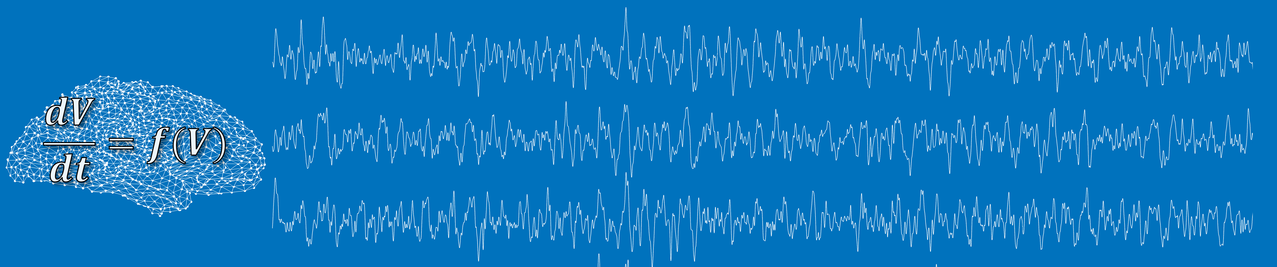
Brain Modelling Workshop Session 1: Introduction to dynamical systems
Luke Tait Marinho Lopes, Alex Shaw, Dominik Krzeminski Slides + practical files: www.github.com/lukewtait/intro_to_modelling
Questions: brainmodelworkshop.freeforums.net
Please unmute your mic at any point to ask questions. I will also ask you some questions throughout, so be ready to unmute to supply answers!

Slide 2
Aims of this tutorial
Aims: Introduce non-mathematicians (e.g. neuroscientists, psychologists) to concepts and mathematical background behind models of brain dynamics.
By the end of this tutorial, you will be able to:
Differentiate between different types and levels of brain models
Understand some basic terminology in the field of dynamical systems
Implement and solve a model of brain dynamics, particularly cortical gamma oscillations

Slide 3
Background on this tutorial + the workshop
First session of a planned one-day event introducing brain modelling through three practical tutorials and two keynote seminars
Postponed due to covid-19
At present we intend to keep the remaining tutorial sessions running in a one-day event when the University reopens
However, depending on the length of the closures and the success of this virtual workshop, we may additionally choose to deliver other sessions virtually.
Feedback on the event and remote delivery is therefore greatly appreciated

Slide 4
Introduction to brain models

Slide 5

Types of computational model
Cognitive models: Explains behavioural data
Computational neuroscience: Explains neuronal activity patterns
Artificial Intelligence: Performs complex tasks

Slide 6
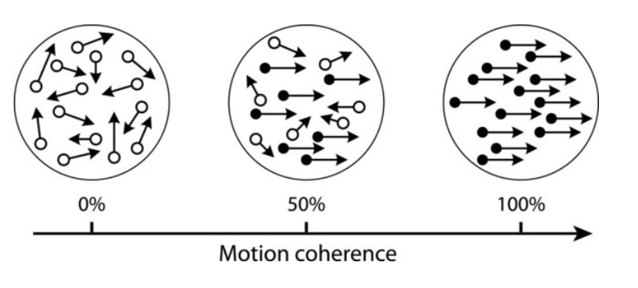
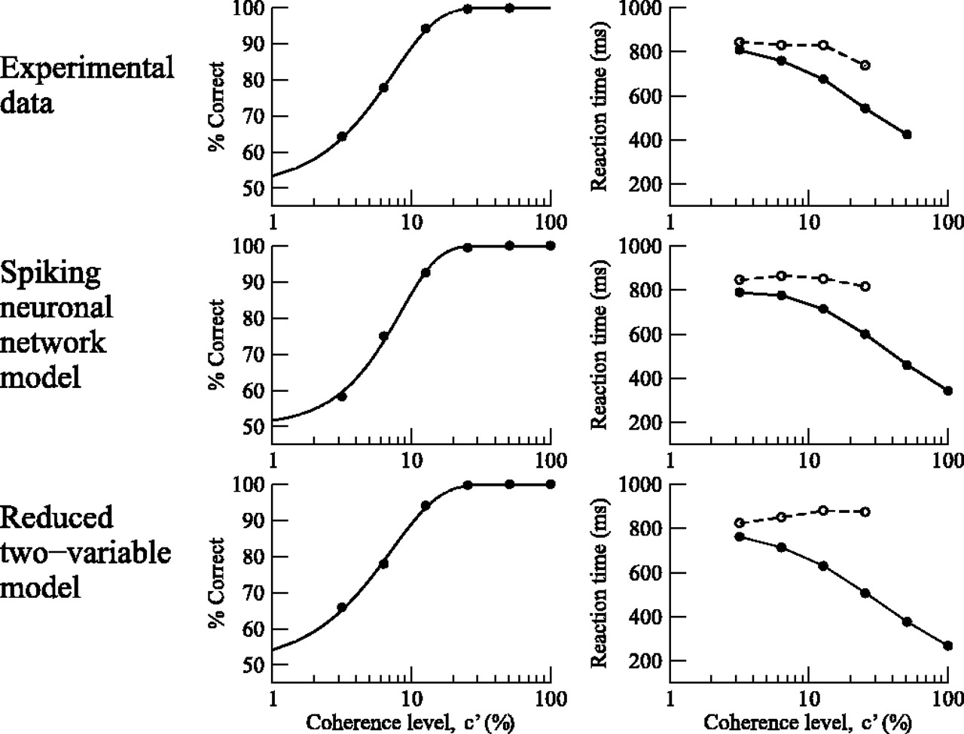

Slide 7
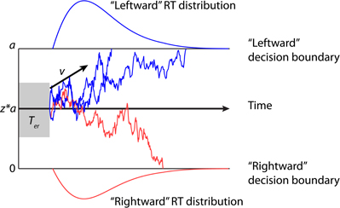
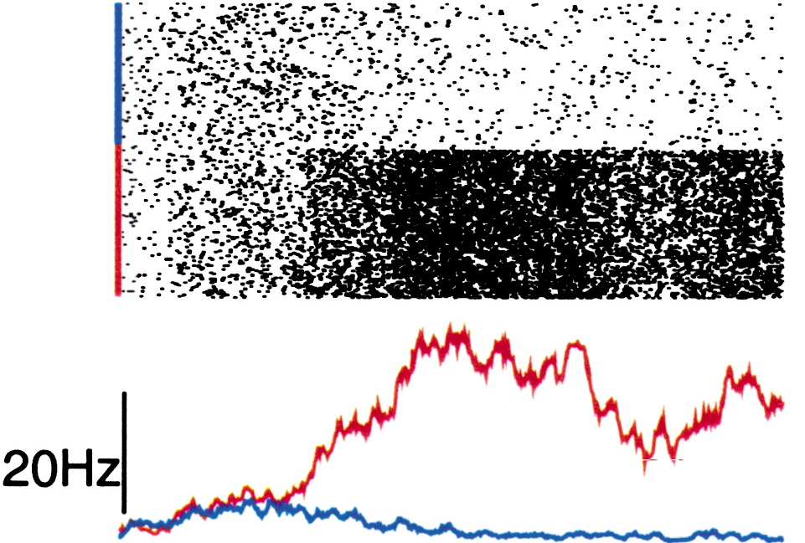
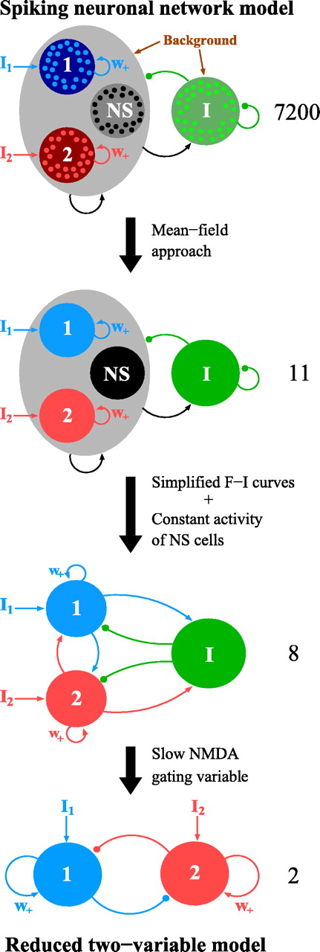
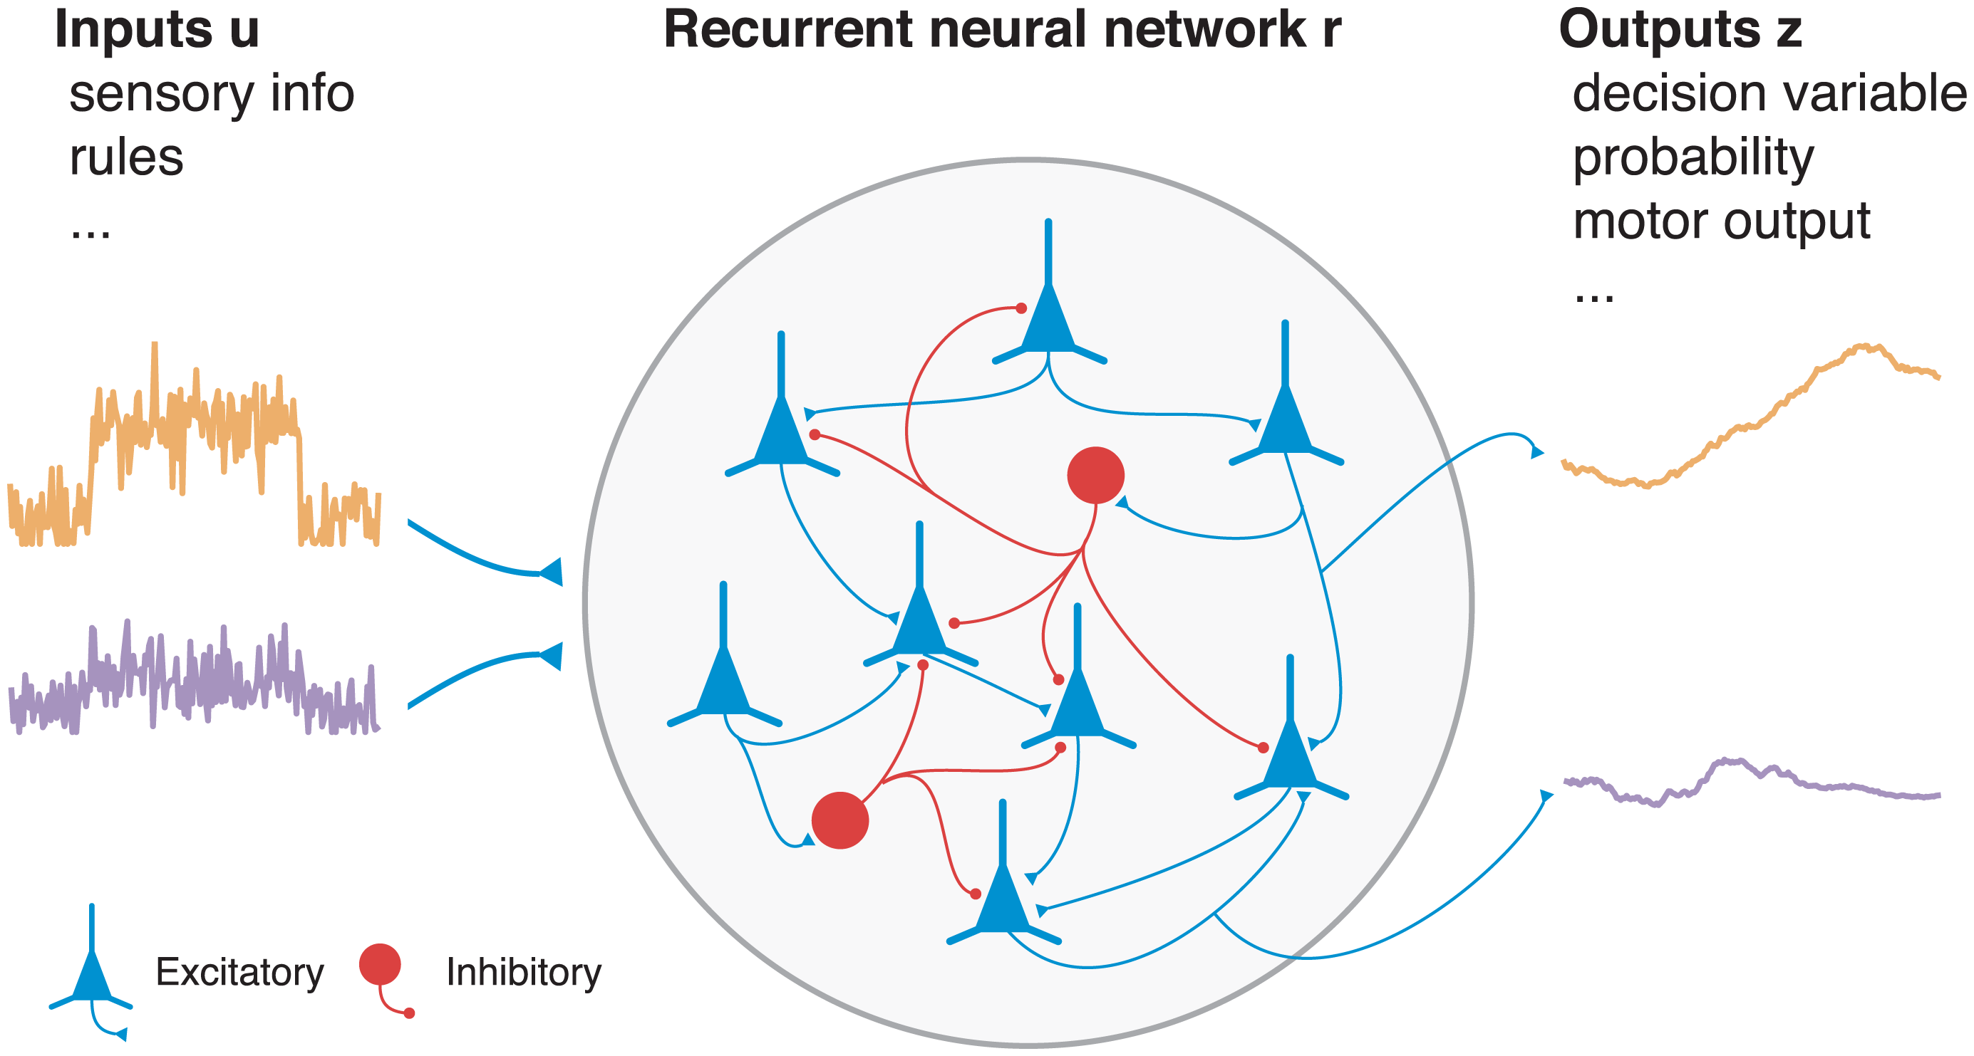
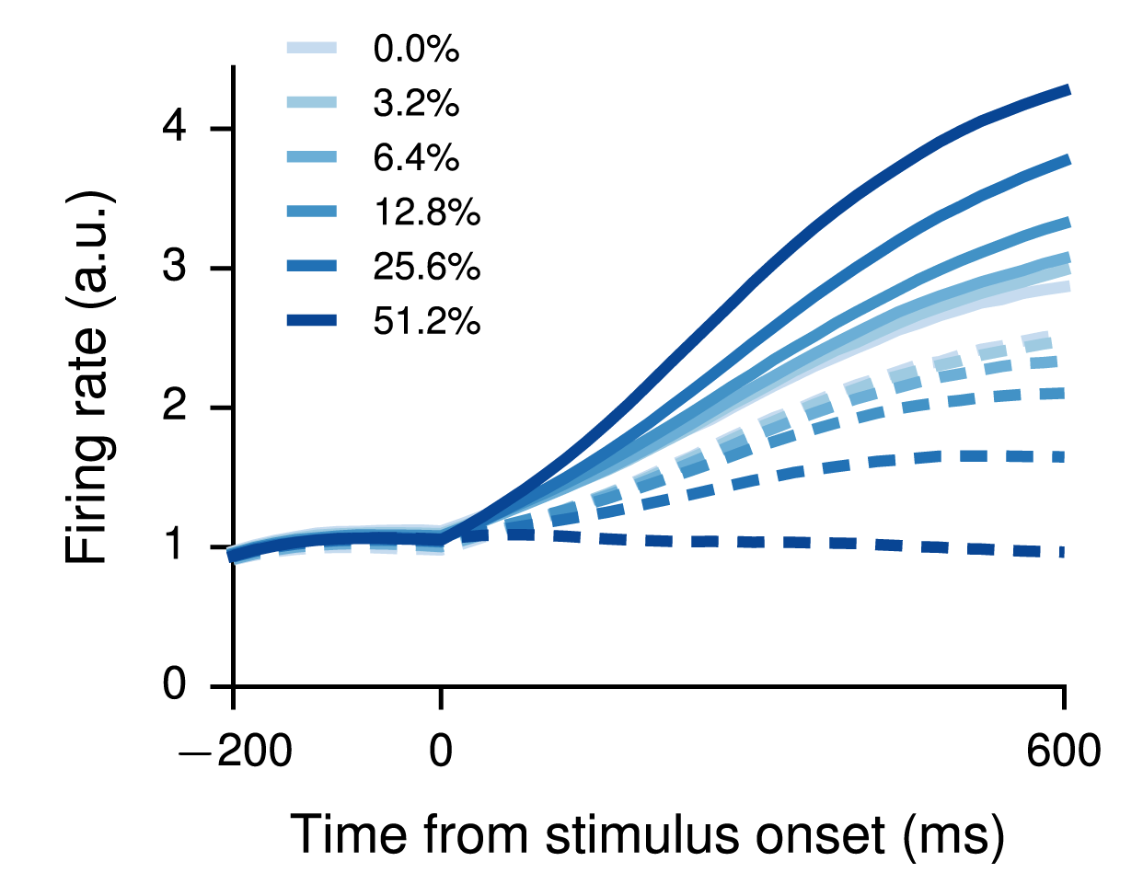
Wong and Wang (2006) J Neurosci
Zhang and Rowe (2014) Front Neurosci
Wang (2002) Neuron
Song et al. (2016) PLoS Comput Biol

Slide 8
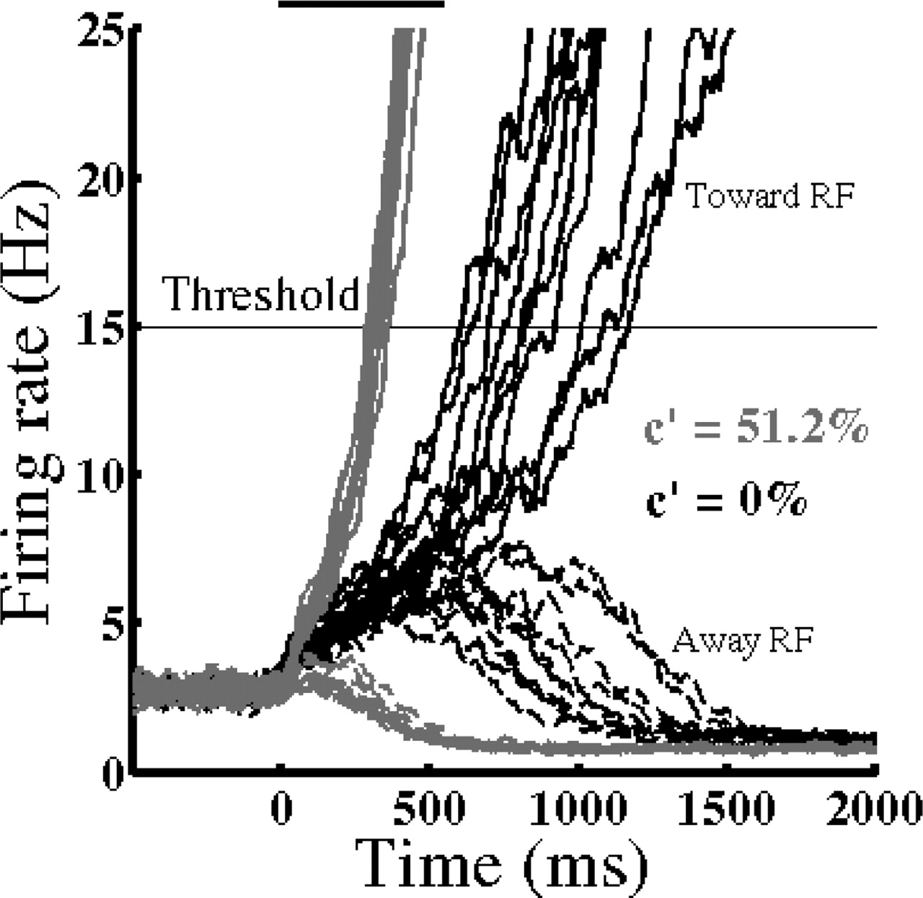
Data
Spiking neuron model
Firing rate model
Wong and Wang (2006) J Neurosci

Slide 9
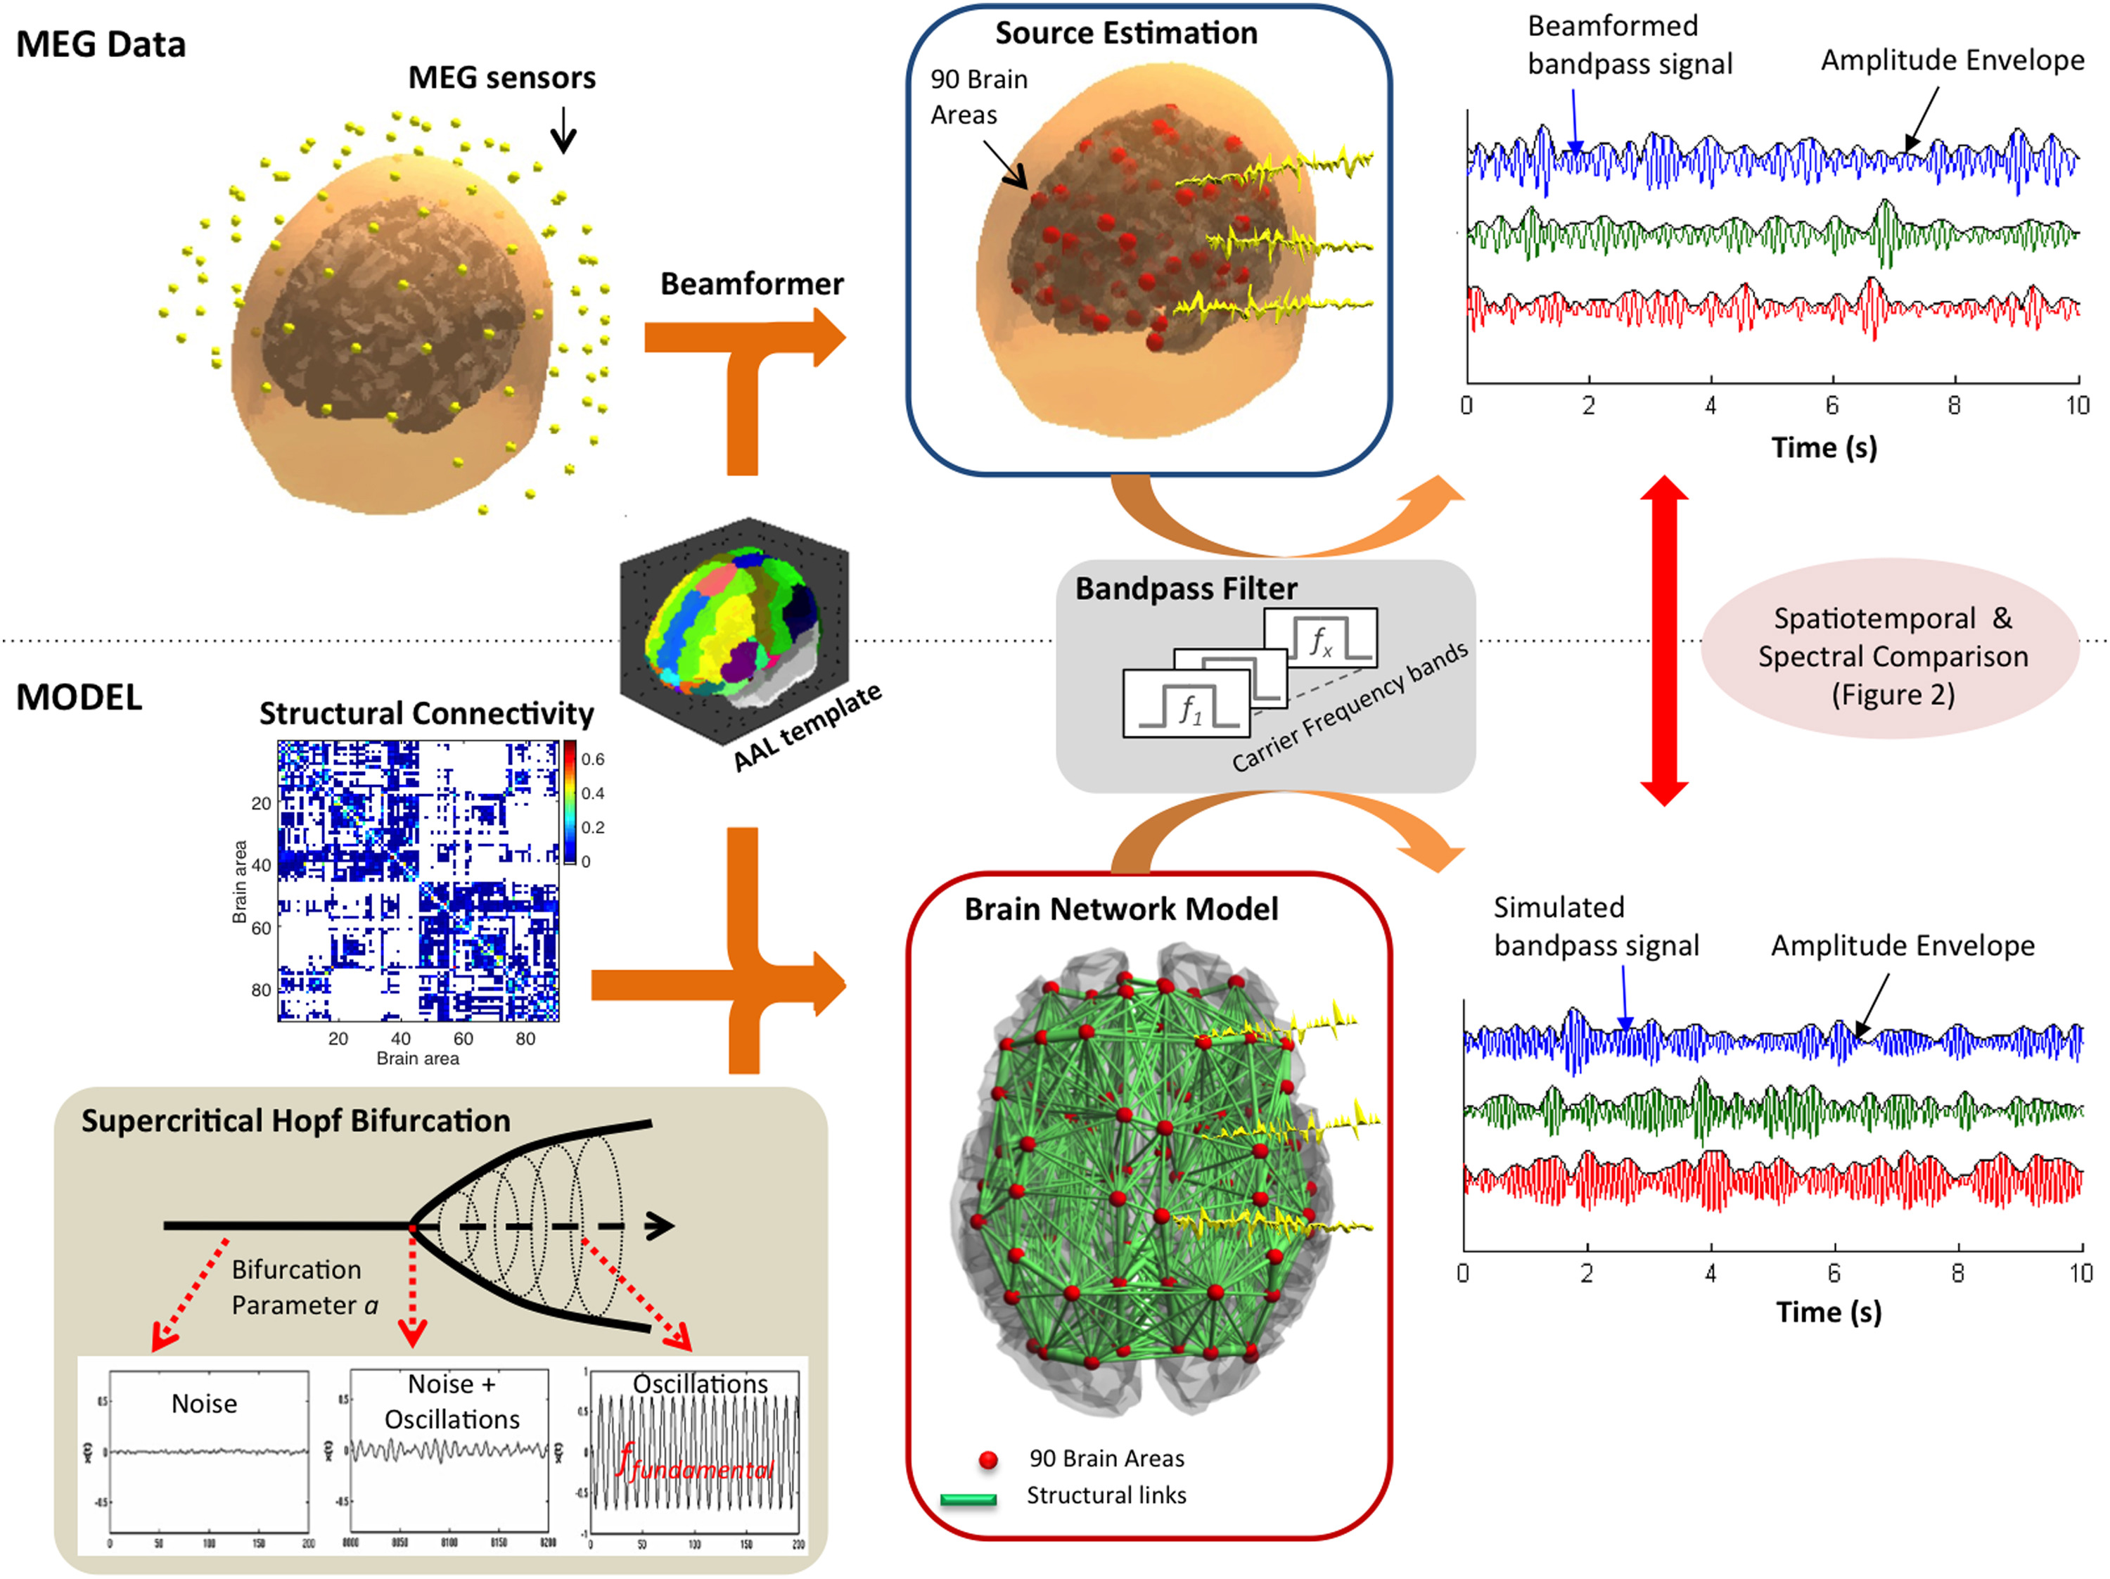
Deco et al. (2017) NeuroImage

Slide 10

Introduction to Dynamical Systems

Slide 11

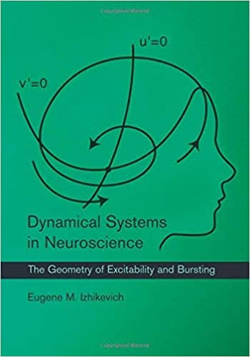

Slide 12
What are dynamical systems?
A dynamical system is a mathematical description of something that evolves over time

Slide 13

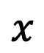
What are dynamical systems?
A dynamical system is a mathematical description of something that evolves over time
speed
$$x$$

Slide 14
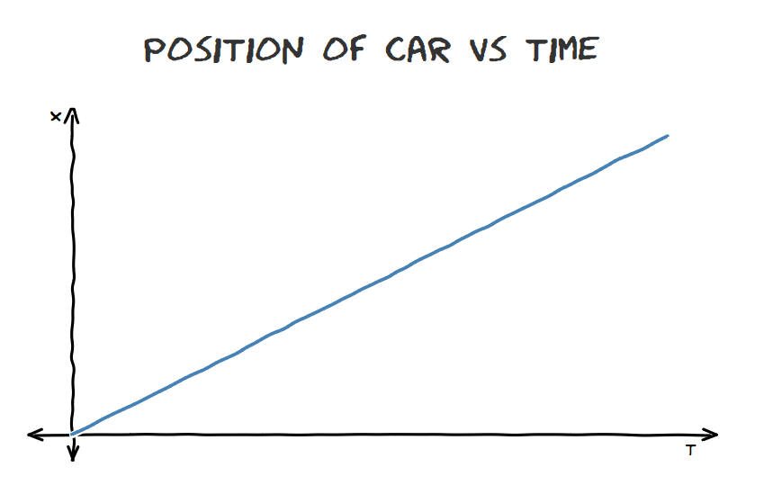
How to quantify speed?

Slide 15
How to quantify speed?
ΔT

Slide 16
How to quantify speed?
SPEED = ΔX/ΔT
ΔX
ΔT

Slide 17
How to quantify speed?
SPEED₁ = SPEED₂
ΔX₂
ΔX₁
ΔT₁
ΔT₂

Slide 18

How to quantify speed?

Slide 19
How to quantify speed?
SPEED₁ ≠ SPEED₂
ΔX₂
ΔX₁
ΔT₁
ΔT₂

Slide 20
How to quantify speed?
SPEED = ΔX/ΔT AS ΔT→0
ΔX
ΔT→0

Slide 21
How to quantify speed?
SPEED = ΔX/ΔT AS ΔT→0
ΔX
ΔT→0

Slide 22
What are dynamical systems?
SPEED = dX/dT
dX
dT

Slide 23
What are dynamical systems?
SPEED = dX/dT
dX
dT

Slide 24
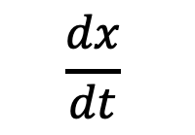
What are dynamical systems?
A dynamical system is a mathematical description of something that evolves over time
$$\frac{dx}{dt}$$
$$x$$

Slide 25
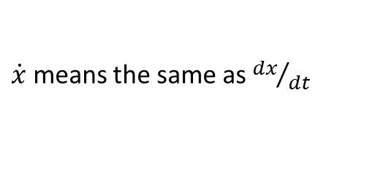
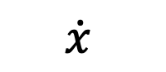
What are dynamical systems?
A dynamical system is a mathematical description of something that evolves over time
$\dot{x}$ means the same as ${dx}/{dt}$
$$\dot{x}$$
$$x$$

Slide 26
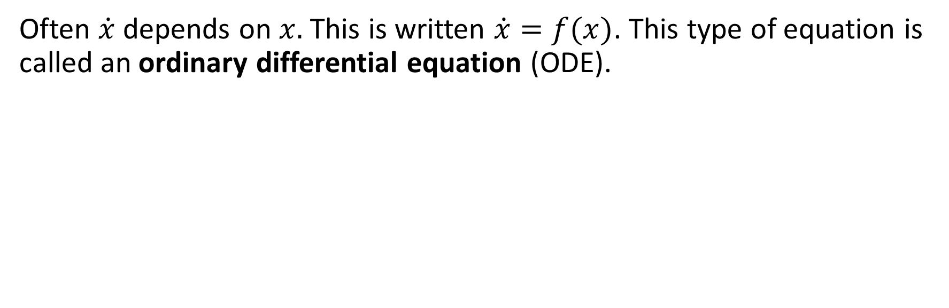
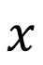
What are dynamical systems?
Often $\dot{x}$ depends on $x.$ This is written $\dot{x}=f(x)$. This type of equation is called an ordinary differential equation (ODE).
$$x$$

Slide 27
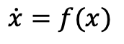

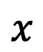
What are dynamical systems?
Often $\dot{x}$ depends on $x.$ This is written $\dot{x}=f(x)$. This type of equation is called an ordinary differential equation (ODE).
$$\dot{x}=f(x)$$
$$\dot{x}$$
$$x$$

Slide 28
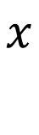
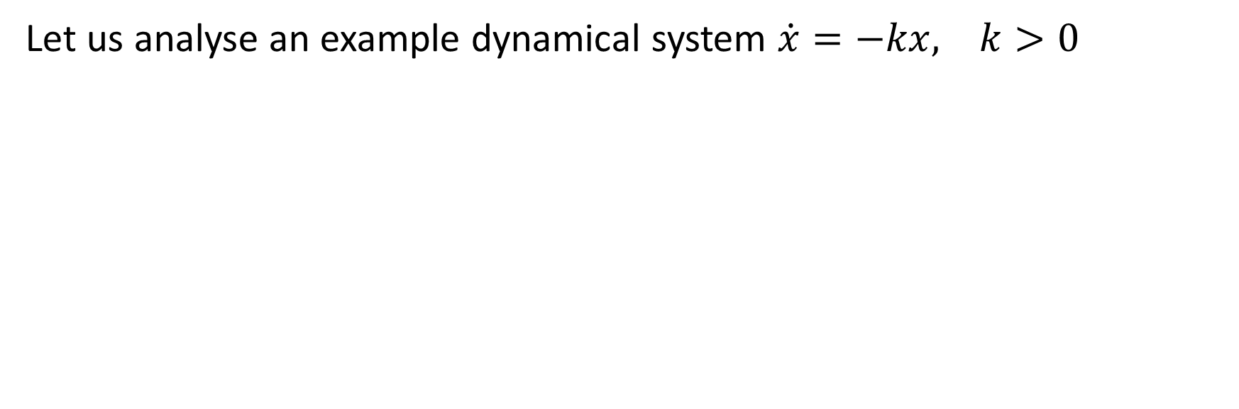

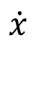
Analysing dynamical systems
Let us analyse an example dynamical system $\dot{x}=−kx, k>0$
$$\dot{x}$$
$$0$$
$$x$$

Slide 29
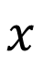

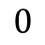
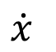
Analysing dynamical systems
We will think about $\dot{x}$ once again as the speed of a car on a track
$$\dot{x}$$
$$0$$
$$x$$

Slide 30

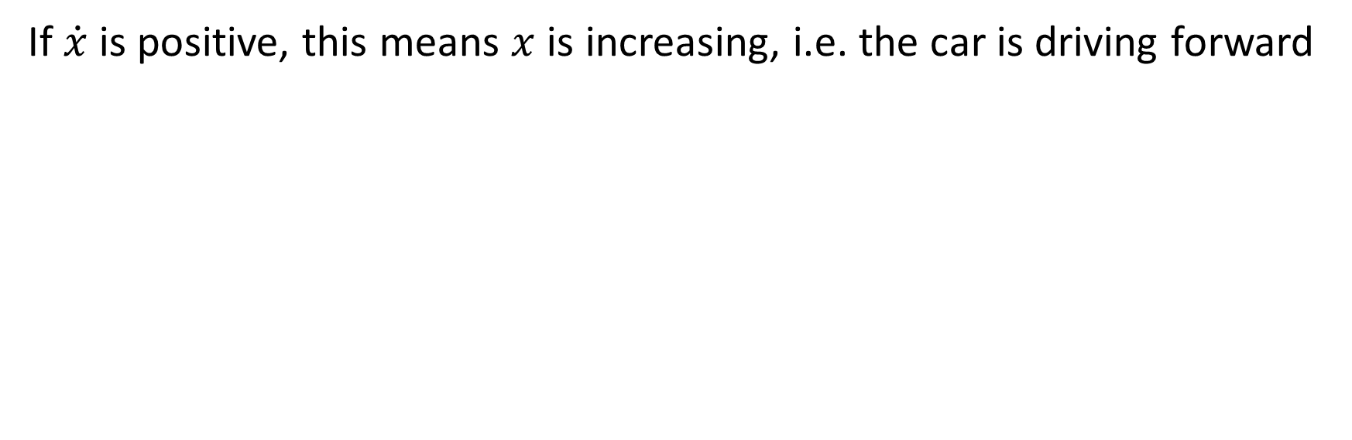

Analysing dynamical systems
If $\dot{x}$is positive, this means $x$ is increasing, i.e. the car is driving forward
$$\dot{x}$$
$$0$$
$$x$$

Slide 31
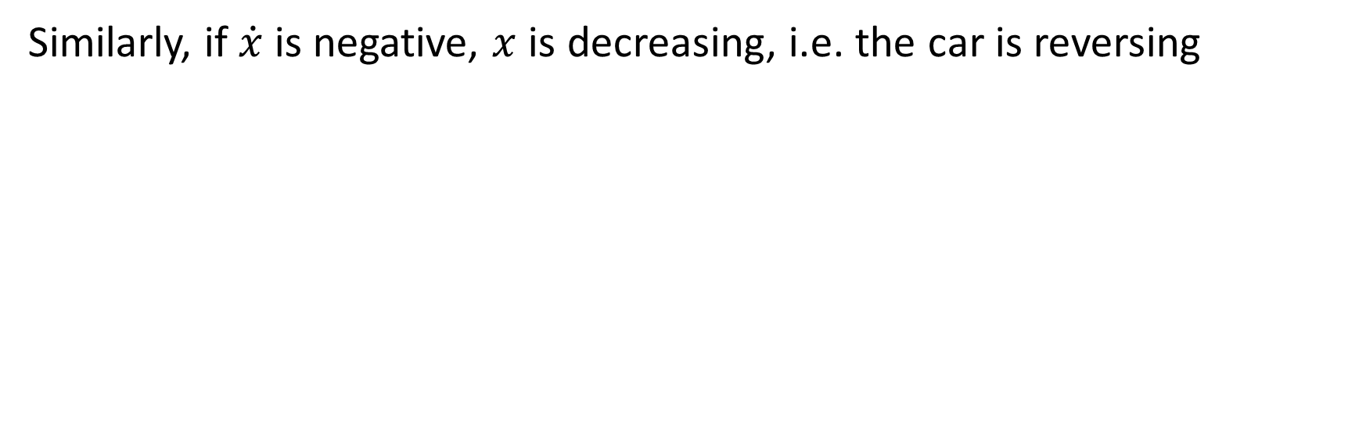
Analysing dynamical systems
Similarly, if $\dot{x}$is negative, $x$ is decreasing, i.e. the car is reversing
$$\dot{x}$$
$$0$$
$$x$$

Slide 32

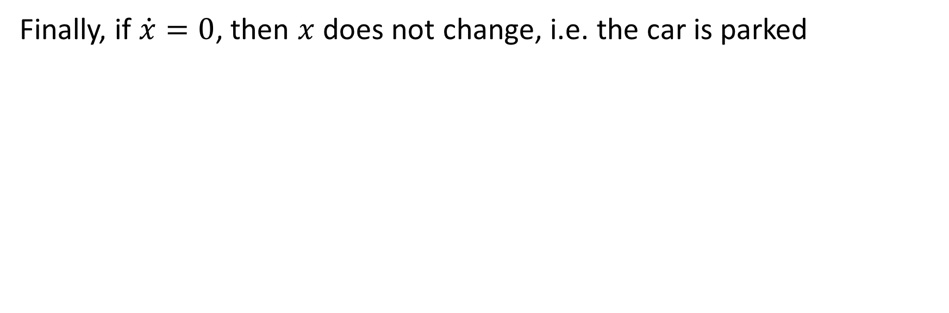
Analysing dynamical systems
Finally, if $\dot{x}=0$, then $x$ does not change, i.e. the car is parked
$$\dot{x}$$
$$0$$
$$x$$

Slide 33
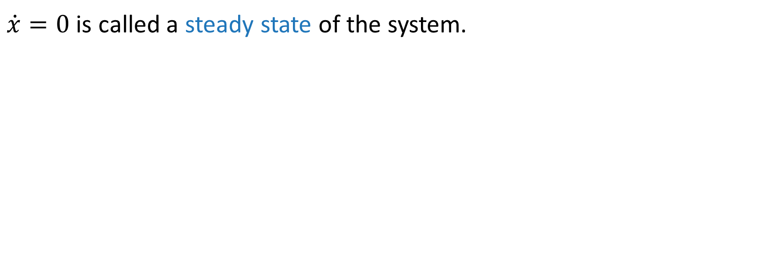
Analysing dynamical systems
$\dot{x}=0$ is called a steady state of the system.
$$\dot{x}$$
$$0$$
$$x$$

Slide 34

Question
Find the steady state of the ODE
$\dot{x}=2x−10$

Slide 35
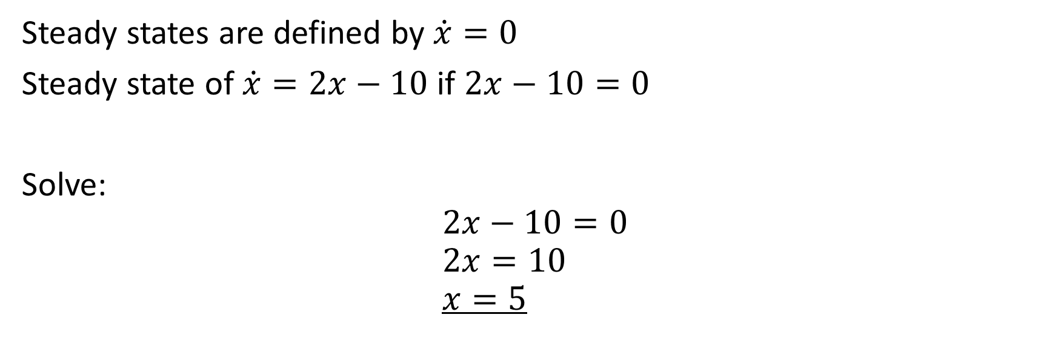
Answer
Steady states are defined by $\dot{x}=0$
Steady state of $\dot{x}=2x−10$ if $2x−10=0$
Solve:
$$2x−10=0 \\ 2x=10 \\ x=5$$

Slide 36
Analysing dynamical systems
Using this graph, we can now predict what the system will do given some start point (initial conditions)
$$\dot{x}$$
$$0$$
$$x$$

Slide 37
Stable and unstable steady states
If the system is in the vicinity of the steady state, it moves towards the steady state. We call this type of steady state stable.
$$\dot{x}$$
$$0$$
$$x$$

Slide 38
Stable and unstable steady states
Conversely, if the system has initial conditions in the vicinity of an unstable it moves away from the steady state.
$$\dot{x}$$
$$0$$
$$x$$

Slide 39
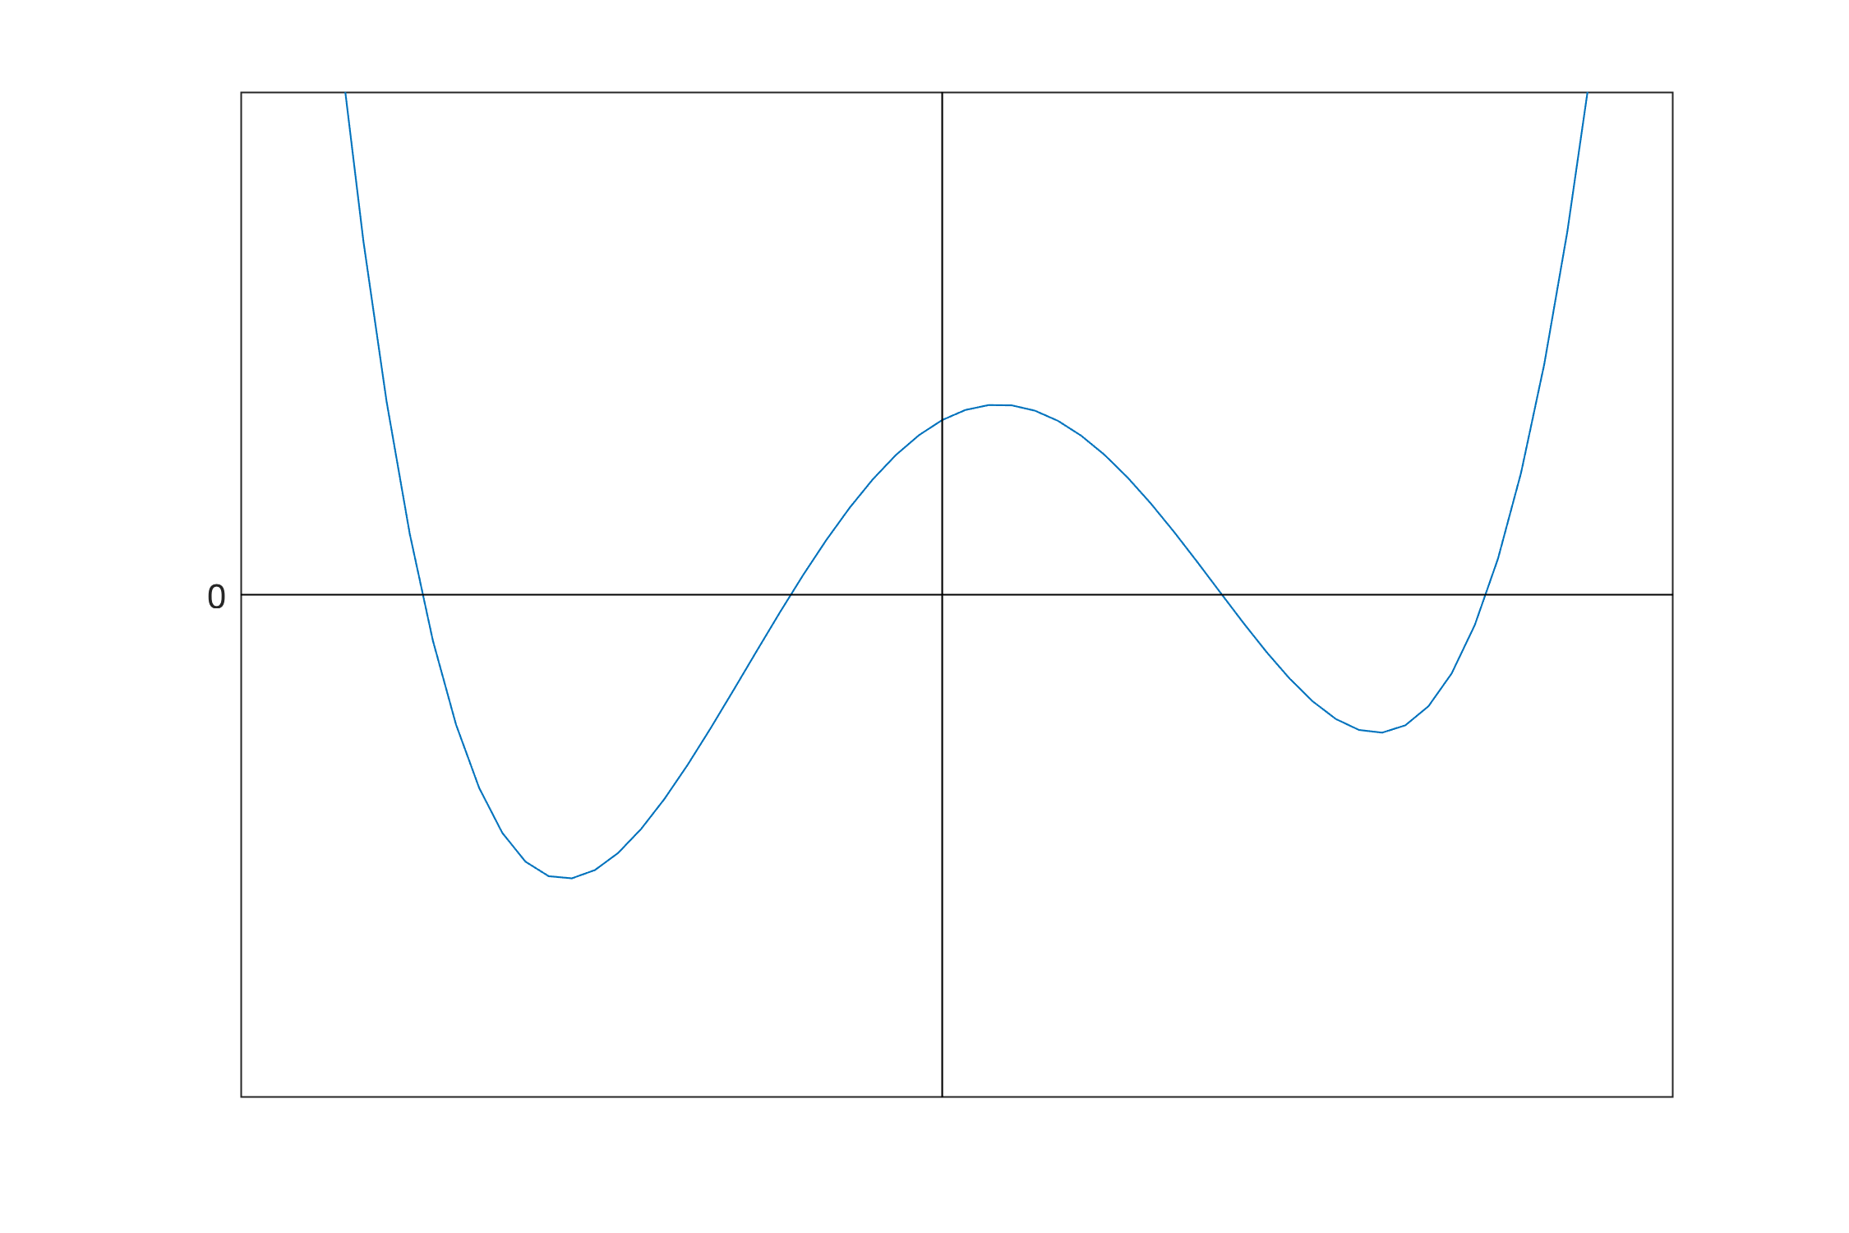
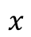
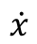
Stable and unstable steady states
$$\dot{x}$$
$$x$$

Slide 40
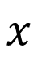
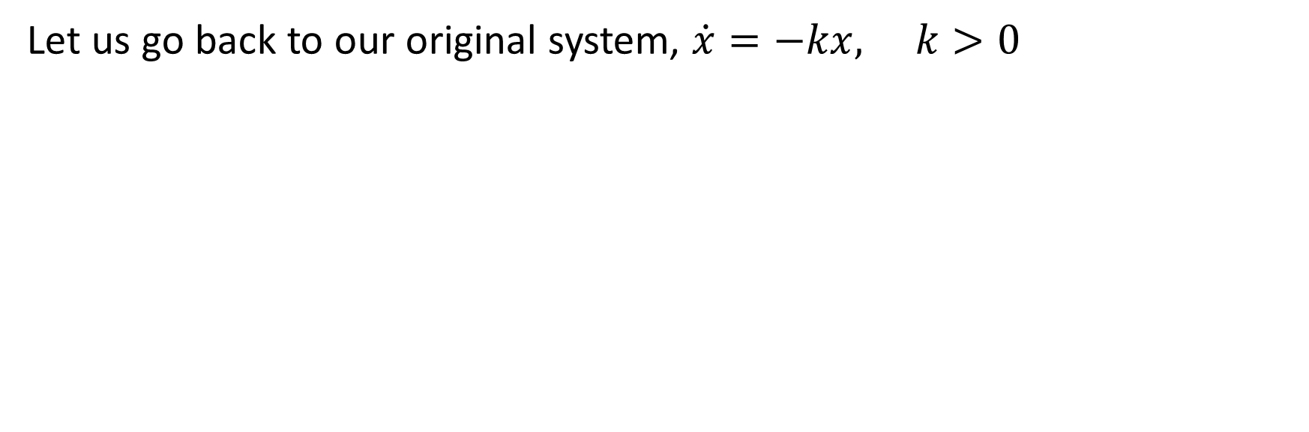

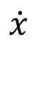
Firing rate models
Let us go back to our original system, $\dot{x}=−kx, k>0$
$$\dot{x}$$
$$0$$
$$x$$

Slide 41
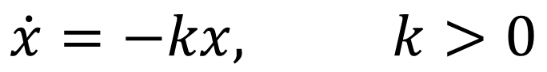
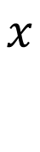
Firing rate models
$$\dot{x}$$
$$\dot{x}=−kx, k>0$$
$$x$$
$$0$$

Slide 42
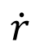
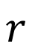
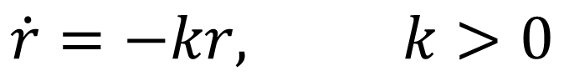
Firing rate models
$$\dot{r}$$
$$\dot{r}=−kr, k>0$$
$$r$$
$$0$$

Slide 43
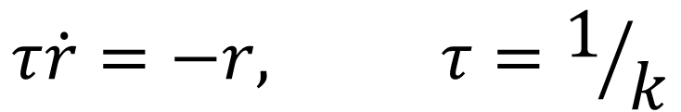
Firing rate models
$$\dot{r}$$
$$τ\dot{r}=−r, τ=1/k$$
$$r$$
$$0$$

Slide 44
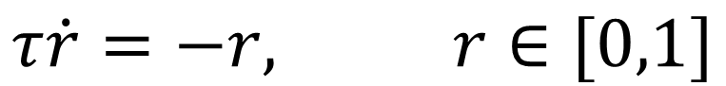
Firing rate models
$$\dot{r}$$
$$τ\dot{r}=−r, r∈[0,1]$$
$$r$$
$$0$$

Slide 45
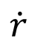
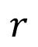
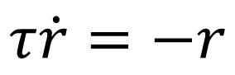
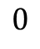
Firing rate models
$$τ\dot{r}=−r$$
$$0$$
$$r$$
$$\dot{r}$$

Slide 46
Firing rate models
$$τ\dot{r}=−r$$
$$0$$
$$r$$
Population firing rate r
$$\dot{r}$$

Slide 47
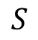
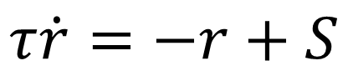
Firing rate models
$$S$$
$$τ\dot{r}=−r+S$$
$$0$$
$$r$$
$$\dot{r}$$

Slide 48



Firing rate models
$$S$$
$$τ\dot{r}=−r+S(input)$$
$$0$$
$$r$$
S is a function of the input to the system, i.e. input-output relationship. It is typically a sigmoid.
Population firing rate r
$$\dot{r}$$
Stimulus
$$S\left(input\right)=\frac{1}{1+\exp\left(−k\left(input−θ\right)\right)}$$

Slide 49


Firing rate models

Slide 50

Summary of 1d dynamical systems
A dynamical system is something that evolves over time
We describe (continuous) dynamical systems using ordinary differential equations (ODEs)
A one dimensional system (one equation) has 2 types of asymptotic dynamics:
$x→±∞$
$x→x^{∗}$
$x^{∗}$ is called a steady state, and can be stable or unstable

Slide 51
Higher dimensional dynamical systems

Slide 52

Higher dimensional dynamical systems
In nature many systems have types of dynamics that are not either a steady state or increasing/decreasing forever
Example: oscillations such as the brain’s alpha, gamma, etc rhythms
To capture these types of dynamics, we need higher dimensional dynamic systems
The dimension of the system is the number of equations
1d: $\dot{x}=f\left(x\right)$ 2d: $\dot{x}=f\left(x,y\right), \dot{y}=g\left(x,y\right)$ 3d: $\dot{x}=f\left(x,y,z\right), \dot{y}=g\left(x,y,z\right), \dot{z}=h(x,y,z)$

Slide 53

Question
Find the steady state of the system
$$\dot{x}=y−2 \\ \dot{y}=2x+y$$

Slide 54

Hint
Steady states are defined by $\dot{x}=0$ and $\dot{y}=0$
Find $x$ and $y$ such that
$$y−2=0 \\ 2x+y=0$$

Slide 55

Answer
Steady states are defined by $\dot{x}=0$ and $\dot{y}=0$
Solve eqn 1:
$$y−2=0→y=2$$
Solve eqn 2 for $y=2$:
$$2x+y=0→2x+2=0→x=−1$$
Steady state at: $\left(x,y\right)=\left(−1,2\right)$

Slide 56

Breakspear (2017)

Slide 57
The Wilson-Cowan model
The Wilson-Cowan model is a two-dimensional version of the firing rate model we saw earlier
$$S$$
$$τ\dot{r}=−r+S(input)$$
$$0$$
$$r$$
S is a function of the input to the system, i.e. input-output relationship. It it typically a sigmoid.
Population firing rate r
$$\dot{r}$$
Stimulus
$$S\left(input\right)=\frac{1}{1+\exp\left(−k\left(input−θ\right)\right)}$$

Slide 58











The Wilson-Cowan model
$$c_{EE}$$
$$τ_{E}\dot{E}=−E+S_{E}\left(input to E\right)$$
$$τ_{I}\dot{I} =−I+S_{I}\left(input to I\right)$$
Excitatory population firing rate, E
Stimulus, $P$
$$S_{E}$$
$$c_{EI}$$
$$c_{IE}$$
Inhibitory population firing rate, I
A simplified schematic from
Daffertshofer and van Wijk (2011)
Note the additional input from other cortical areas ($∑C_{kl}E_{l}$)
$$S_{E}\left(input\right)=\frac{1}{1+\exp\left(−k_{E}\left(input−θ_{E}\right)\right)}$$
$$S_{I}$$
$$S_{I}\left(input\right)=\frac{1}{1+exp\left(−k_{I}\left(input−θ_{I}\right)\right)}$$

Slide 59

The Wilson-Cowan model
$$c_{EE}$$
$$τ_{E}\dot{E}=−E+S_{E}\left(P+…\right)$$
$$τ_{I}\dot{I} =−I+S_{I}\left(input to I\right)$$
Excitatory population firing rate, E
Stimulus, $P$
$$S_{E}$$
$$c_{EI}$$
$$c_{IE}$$
Inhibitory population firing rate, I
A simplified schematic from
Daffertshofer and van Wijk (2011)
Note the additional input from other cortical areas ($∑C_{kl}E_{l}$)
$$S_{E}\left(input\right)=\frac{1}{1+\exp\left(−k_{E}\left(input−θ_{E}\right)\right)}$$
$$S_{I}$$
$$S_{I}\left(input\right)=\frac{1}{1+exp\left(−k_{I}\left(input−θ_{I}\right)\right)}$$

Slide 60

The Wilson-Cowan model
$$c_{EE}$$
$$τ_{E}\dot{E}=−E+S_{E}\left(P+c_{EE}E+…\right)$$
$$τ_{I}\dot{I} =−I+S_{I}\left(input to I\right)$$
Excitatory population firing rate, E
Stimulus, $P$
$$S_{E}$$
$$c_{EI}$$
$$c_{IE}$$
Inhibitory population firing rate, I
A simplified schematic from
Daffertshofer and van Wijk (2011)
Note the additional input from other cortical areas ($∑C_{kl}E_{l}$)
$$S_{E}\left(input\right)=\frac{1}{1+\exp\left(−k_{E}\left(input−θ_{E}\right)\right)}$$
$$S_{I}$$
$$S_{I}\left(input\right)=\frac{1}{1+exp\left(−k_{I}\left(input−θ_{I}\right)\right)}$$

Slide 61

The Wilson-Cowan model
$$c_{EE}$$
$$τ_{E}\dot{E}=−E+S_{E}\left(P+c_{EE}E−c_{IE}I\right)$$
$$τ_{I}\dot{I} =−I+S_{I}\left(input to I\right)$$
Excitatory population firing rate, E
Stimulus, $P$
$$S_{E}$$
$$c_{EI}$$
$$c_{IE}$$
Inhibitory population firing rate, I
A simplified schematic from
Daffertshofer and van Wijk (2011)
Note the additional input from other cortical areas ($∑C_{kl}E_{l}$)
$$S_{E}\left(input\right)=\frac{1}{1+\exp\left(−k_{E}\left(input−θ_{E}\right)\right)}$$
$$S_{I}$$
$$S_{I}\left(input\right)=\frac{1}{1+exp\left(−k_{I}\left(input−θ_{I}\right)\right)}$$

Slide 62

The Wilson-Cowan model
$$c_{EE}$$
$$τ_{E}\dot{E}=−E+S_{E}\left(P+c_{EE}E−c_{IE}I\right)$$
$$τ_{I}\dot{I} =−I+S_{I}\left(c_{EI}E−c_{II}I\right)$$
Excitatory population firing rate, E
Stimulus, $P$
$$S_{E}$$
$$c_{EI}$$
$$c_{IE}$$
Inhibitory population firing rate, I
A simplified schematic from
Daffertshofer and van Wijk (2011)
Note the additional input from other cortical areas ($∑C_{kl}E_{l}$)
$$S_{E}\left(input\right)=\frac{1}{1+\exp\left(−k_{E}\left(input−θ_{E}\right)\right)}$$
$$S_{I}$$
$$S_{I}\left(input\right)=\frac{1}{1+exp\left(−k_{I}\left(input−θ_{I}\right)\right)}$$

Slide 63

Practical session: Simulating dynamical systems on a computer

Slide 64









The Euler Method
$$x_{i+1}=x_{i}+hf(x_{i})$$
The Euler method is the simplest numerical approximation of a solution to an ODE
It involves calculating the solution at time i+h by calculating the derivative at time I
$$x_{i}+hf(x_{i})$$
$$hf(x_{i})$$
$$f(x_{i})$$
$$x_{i}$$
$$t_{i}$$
$$t_{i}+h$$
$$x(t)$$
Modified from Wirkus and Swift (2015), A Course in Ordinary Differential Equations, 2nd edition.

Slide 65
Practical Session
Download and extract the git repository www.github.com/lukewtait/intro_to_modelling
In this folder, open the subfolder practical1 and work through Worksheet1.pdf.
Check your results are in line with the solutions, in the subfolder practical1/solutions
If you get stuck, you have three options:
Either ask tutors on zoom (until 3pm), or at brainmodelworkshop.freeforums.net (we will check the forums until the 11th, after that please let us know via email that you have posted).
If your issue is with implementation, open SyntaxGuide.pdf, which describes the Matlab syntax required for each task. I’ve tried to include as much detail as possible, starting with how to open Matlab.
Check solution/example codes in the subdirectory practical1/solutions
Asking questions on Zoom:
Tutors will be on Zoom for the next hour, until 3pm, to answer questions.
Feel free to leave the Zoom meeting now. You can rejoin later if you have questions. Alternatively stick around to benefit from others’ questions.
I will be in the main meeting to answer questions, and other tutors will be available in breakout rooms.
If no one is currently asking questions, just unmute your mic and ask. If we are busy, you can reserve your place in line to have your question answered in the chat (e.g. type “I have a question”). You can also directly request to go to a private breakout room in the chat.

